Slide 1

Employee Data Analysis using Excel
STUDENT NAME: S.MOWNICA
REGISTER NO: 312203335/FF75ABA6B8E5A2B85A44EAD9E510FBC4
DEPARTMENT:B.COM (GENERAL)
COLLEGE: PRINCE SHRI VENKATESHWARA ARTS AND SCIENCE COLLEGE
1
Notes:
1

Slide 2

PROJECT TITLE
Employee Performance Analysis using Excel
2

Slide 3



AGENDA
Problem Statement
Project Overview
End Users
Our Solution and Proposition
Dataset Description
Modelling Approach
Results and Discussion
Conclusion
3/21/2024 Annual Review
3

Slide 4

PROBLEM STATEMENT
- Understand the distribution of employee ages, tenure, and
job roles across departments
- Identify high-performing employees and departments
- Analyze employee turnover rates and reasons for leaving
- Determine the impact of training programs on employee
performance
- Develop a predictive model to forecast future staffing needs
4

Slide 5

PROJECT OVERVIEW
•Analyze employee data to understand workforce trends
•Optimize HR strategies
• Improve decision-making through interactive dashboards and
•Predictive modeling.
.
5

Slide 6


WHO ARE THE END USERS?
1. HR Manager
2. HR Business Partners
3. Talent Acquisition Team
4. Learning & Development Team
5. Compensation & Benefits Team
6. Executive Leadership
7. Department Managers
8. Business Analysts
6

Slide 7

OUR SOLUTION AND ITS VALUE PROPOSITION
1.Conditional formatting
- Highlight cells based on conditions (e.g., values, formulas, formatting)
- Visualize data trends and patterns
2.Filter
- Narrow down data to specific criteria
- Hide or show data based on conditions
7

Slide 8
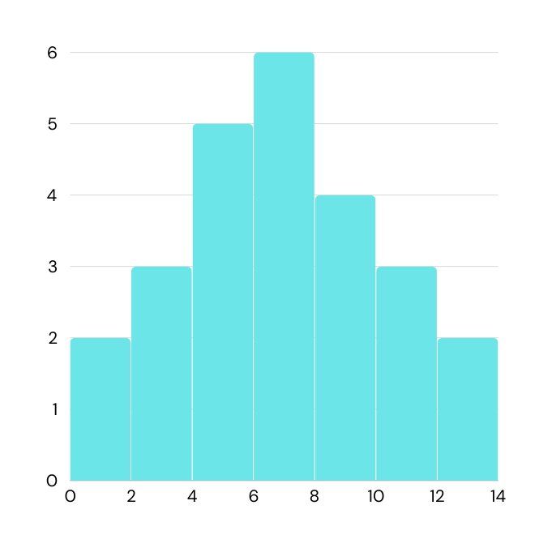
3.Formula
- Perform calculations and data manipulation
- Automate tasks and updates
4.Pivot table
- Summarize and analyze large datasets
- Create custom views and reports
5.Graph
- Visualize data trends and patterns
- Identify correlations and relationships
7

Slide 9
Dataset Description
1.EMPLOYEE - Edunet
2.26 - feature
3.9 - feature
4.Employee ID - numerical
5.Name - text
6.Employee type
7.Performance level
8.Gender - male , female
9.Employee rating - numerical values

Slide 10

THE "WOW" IN OUR SOLUTION
•Performance level =IFS(Z8>=5,"VERY HIGH",Z8>=3,"MED", TRUE,"LOW")
3/21/2024 Annual Review
9

Slide 11
MODELLING
-Download employee data from the Edunet dashboard
1.Data collection
2.Feature collection
- Identified the important feature like employee ID , name , department , job title, age and tenure .
3.Data cleaning
-Find and fix: Missing values, Errors, Inconsistencies
4.Performance level -
Employee performance based on Ratings,Reviews,Goals
5.Pivot table -
Summarize data to:,Count employees by department,Average tenure by job title, Identify trends and patterns.
6.Visualization
Charts and graphs to: Show employee demographics, Illustrate performance trends,Highlight insights
10

Slide 12
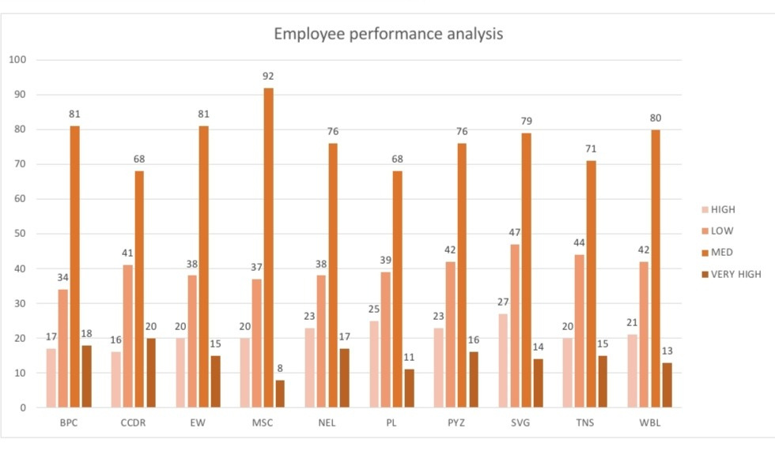
RESULT
11

Slide 13
conclusion
"By creating an employee performance scoreboard in Excel using pivot tables, we have successfully tracked and analyzed employee turnover trends, identifying key insights to inform HR strategies and talent management decisions. This dashboard enables us to:
- Monitor turnover rates by department, job title, and tenure
- Identify high-risk groups and develop targeted retention initiatives
- Evaluate the effectiveness of training programs and development opportunities
- Inform data-driven decisions to reduce turnover and improve employee engagement
This employee performance scoreboard serves as a valuable tool for optimizing our workforce, enhancing employee experience, and driving business success."

